Slide 1

Department of Computer Engineering
Real Time Chat
By: - 1) Deepak Bohara(22113)
2)Abhinav Maindre(22101) 3) Vishwajeet Birajdar(22238)
4)Vikas Dain (22239)
Guided by :- Manjusha Tatitya

Slide 2
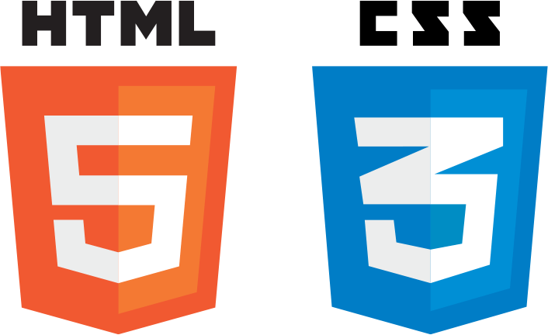
What is Html & CSS?
HTML is the standard markup language for Web pages.
With HTML you can create your own Website.
HTML is easy to learn
CSS is the language we use to style an HTML document.
CSS describes how HTML elements should be displayed.

Slide 3

What is JavaScript?
JavaScript is the world's most popular programming language.
JavaScript is the programming language of the Web.
JavaScript is easy to learn.

Slide 4

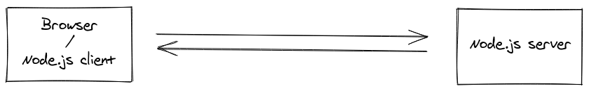
What is Socket.io?
Socket.IO is a library that enables real-time, bidirectional and event-based communication between the browser and the server. It consists of:
a Node.js server: Source | API
a Javascript client library for the browser (which can be also run from Node.js): Source | API

Slide 5
Methodology -
Developer Experience -
The client will try to establish a WebSocket connection if possible, and will fall back on HTTP long polling if not.
WebSocket is a communication protocol which provides a full-duplex and low-latency channel between the server and the browser. More information can be found here.
So, in the best-case scenario, provided that:
the browser supports WebSocket (97% of all browsers in 2020)
there is no element (proxy, firewall, …) preventing WebSocket connections between the client and the server
you can consider the Socket.IO client as a “slight” wrapper around the WebSocket API.
Debugging -
Socket.IO is now completely instrumented by a minimalistic yet tremendously powerful utility called debug by TJ Holowaychuk.
Before 1.0, the Socket.IO server would default to logging everything out to the console. This turned out to be annoyingly verbose for many users (although extremely useful for others), so now we default to being completely silent by default.
The basic idea is that each module used by Socket.IO provides different debugging scopes that give you insight into the internals. By default, all output is suppressed, and you can opt into seeing messages by supplying the DEBUG env variable (Node.JS) or the localStorage.debug property (Browsers).

Slide 6
System Requirements -
Software Requirement:-
For Html,Css & Javascript :-
Compatible Web Browser
For Socket.io :-
npm install socket.io
Hardware Requirement:-
Processor: Minimum 1 GHz; Recommended 2GHz or more.
Ethernet connection (LAN) OR a wireless adapter (Wi-Fi)
Hard Drive: Minimum 32 GB; Recommended 64 GB or more.
Memory (RAM): Minimum 1 GB; Recommended 4 GB or above.

Slide 7
1)Created a public folder which will contain images(for icon,title icon), client.js and css file
2)Inside main folder create index.html, server.js
3)Server.js will contain socket.io definition
4)Client.js will contain backend work for handling for user chats, different functions for handling the chats and interface
Implementation -

Slide 8
style.css shows how the website will look and react with different width of device
index.html contains all import of script file, css file as well as different
image file
5)For hosting the website , we used Heroku which provides free hosting
for lifetime
6)We just need to have Git for heroku for creating repository

Slide 9
Result -
Our Team Members successfully, created the webpage for Real-time chat & we learned about socket.io, javascript, html, css

Slide 10
Challenges Faced -
1) Troubleshooting connection issues
anything between the user and the Socket.IO server may encounter a temporary failure or be restarted
the server itself may be killed as part of an autoscaling policy
the user may lose connection or switch from WiFi to 4G, in case of a mobile browser
the browser itself may freeze an inactive tab
That being said, the Socket.IO client will always try to reconnect, unless specifically told otherwise.
2) Callback-Centric
The callback centric nature of Socket.io is a real downside. Callbacks offer no such guarantees. If a callback needs to do a whole bunch of asynchronous tasks, there’s no way for it to go back to the caller and say, “Hey, can you wait a minute before you invoke me again, I just have to go and store this to a database.” So, an overzealous client can overwhelm a server as it sends events at a higher rate than it can process, causing the server to run out of memory or CPU.

Slide 11
Conclusion -
We created the webpage successfully. Implemented the webpage using Html,Css & Javascript in frontend & Socket.io for Backend. Hosted using heroku & git
Finally, we would like to conclude that our project is successfully working

